Slide 1
Iteration 1 Software Proposal Team3: Bug Killer
Siyuan Xue
Zhuoru Song
Tony Xiang

Slide 2
Iteration 1 Overview — Online Restaurant Ordering System
01
Refined the System Design
02
Initial Database Design
03
User End

Slide 3
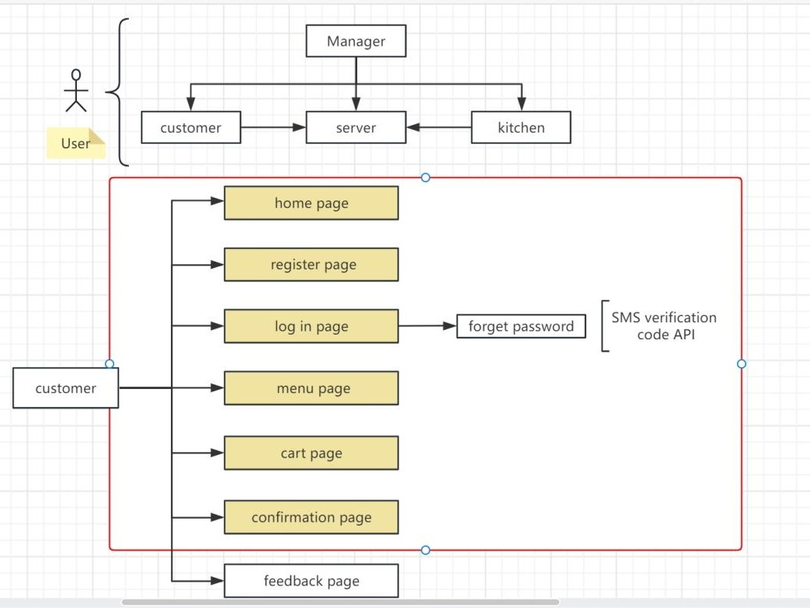

Slide 4
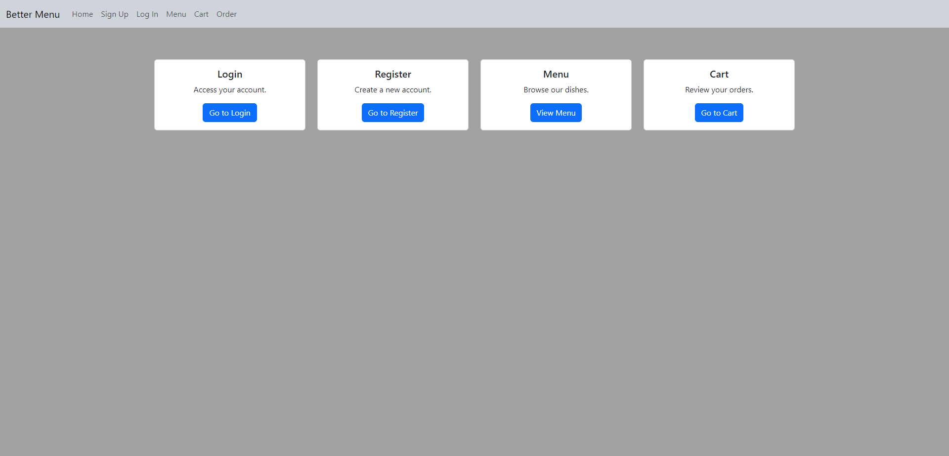

Slide 5
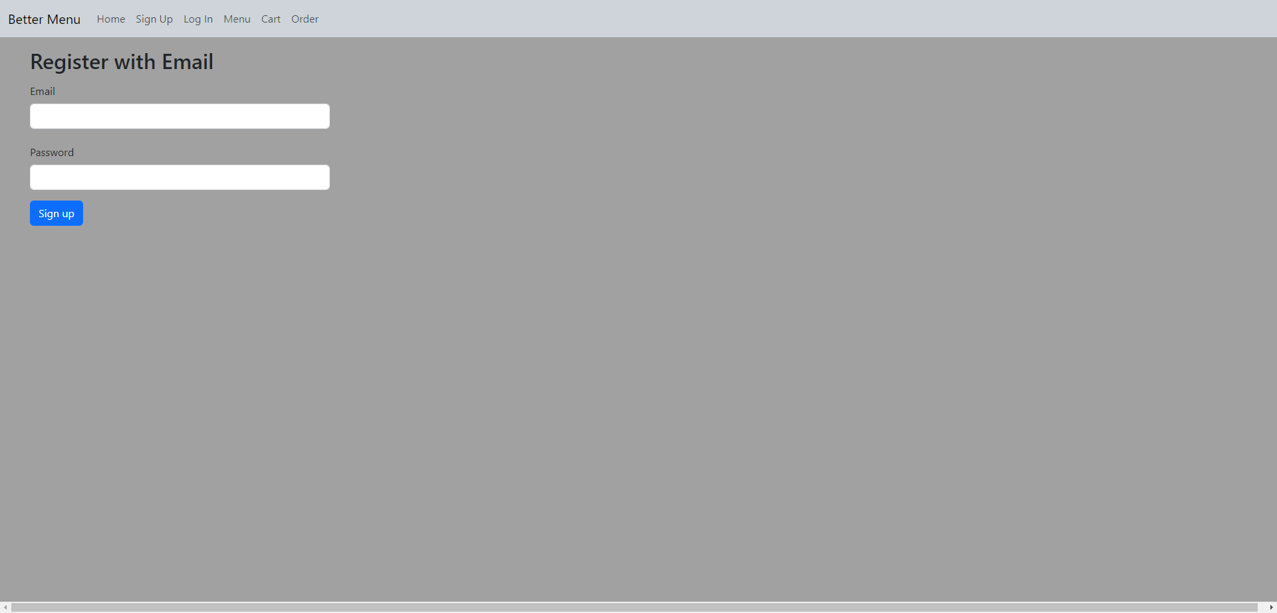

Slide 6
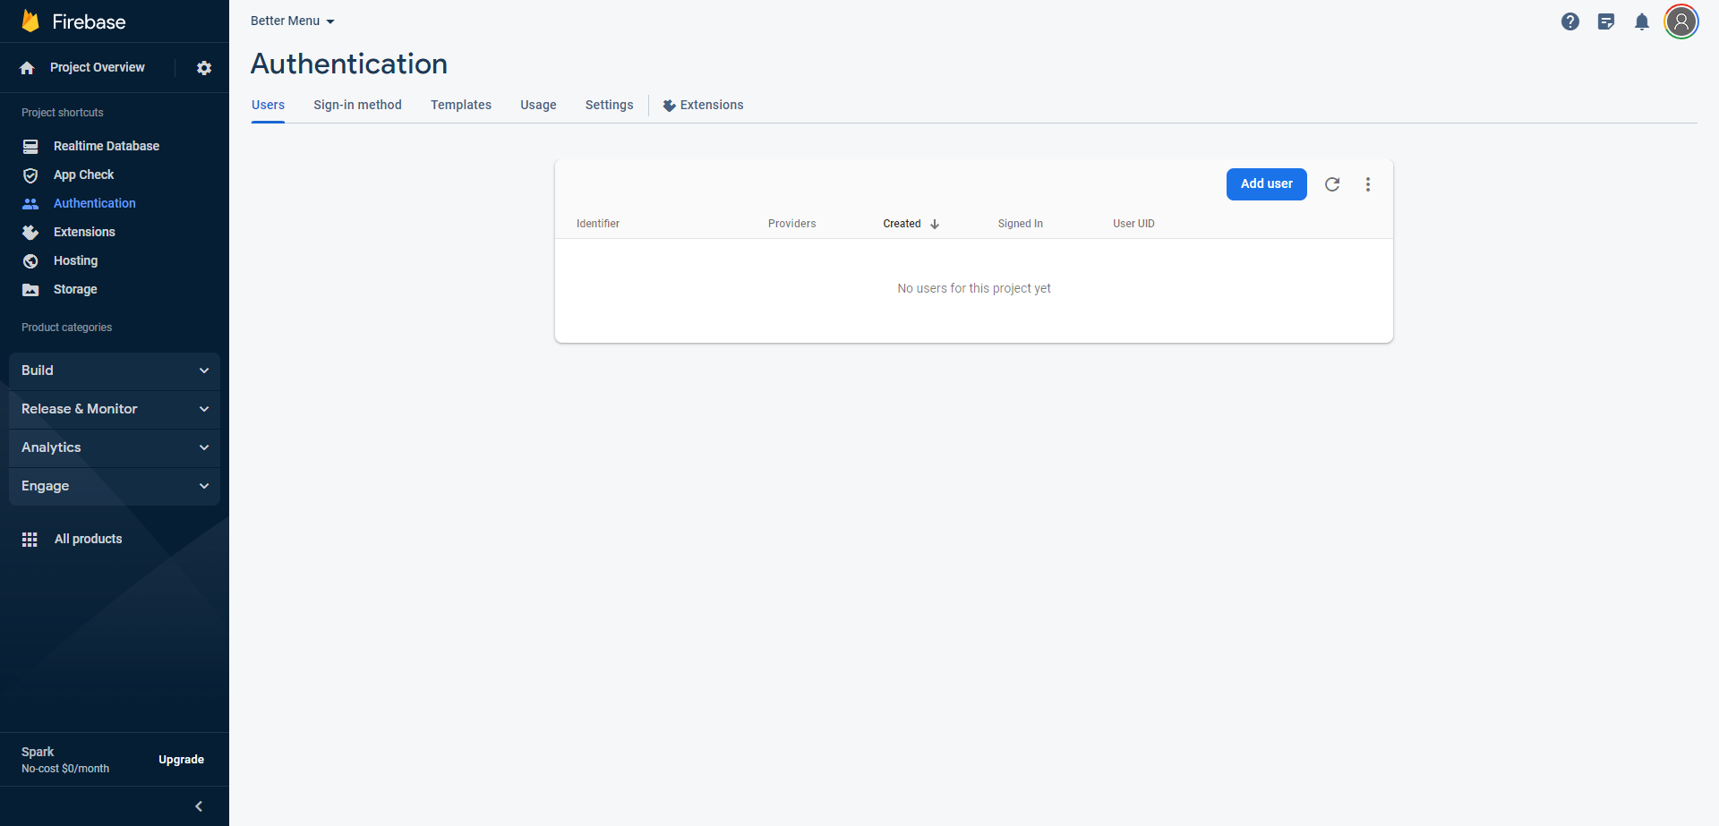

Slide 7
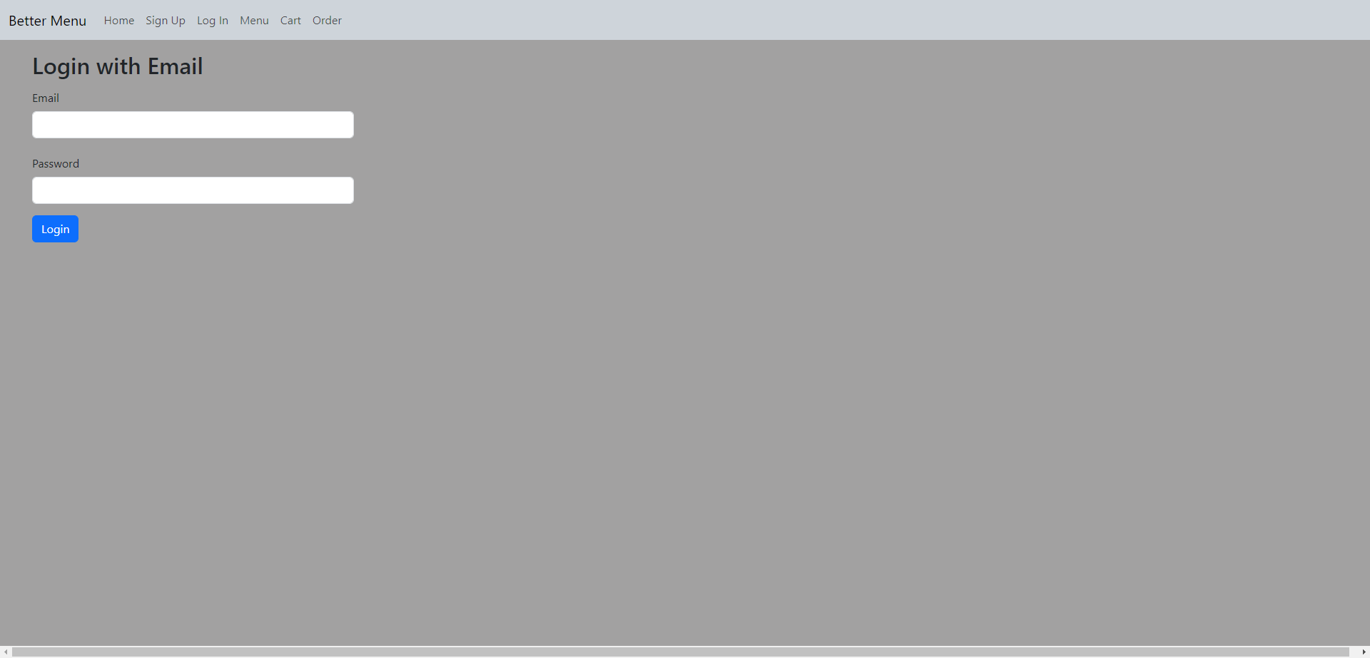

Slide 8
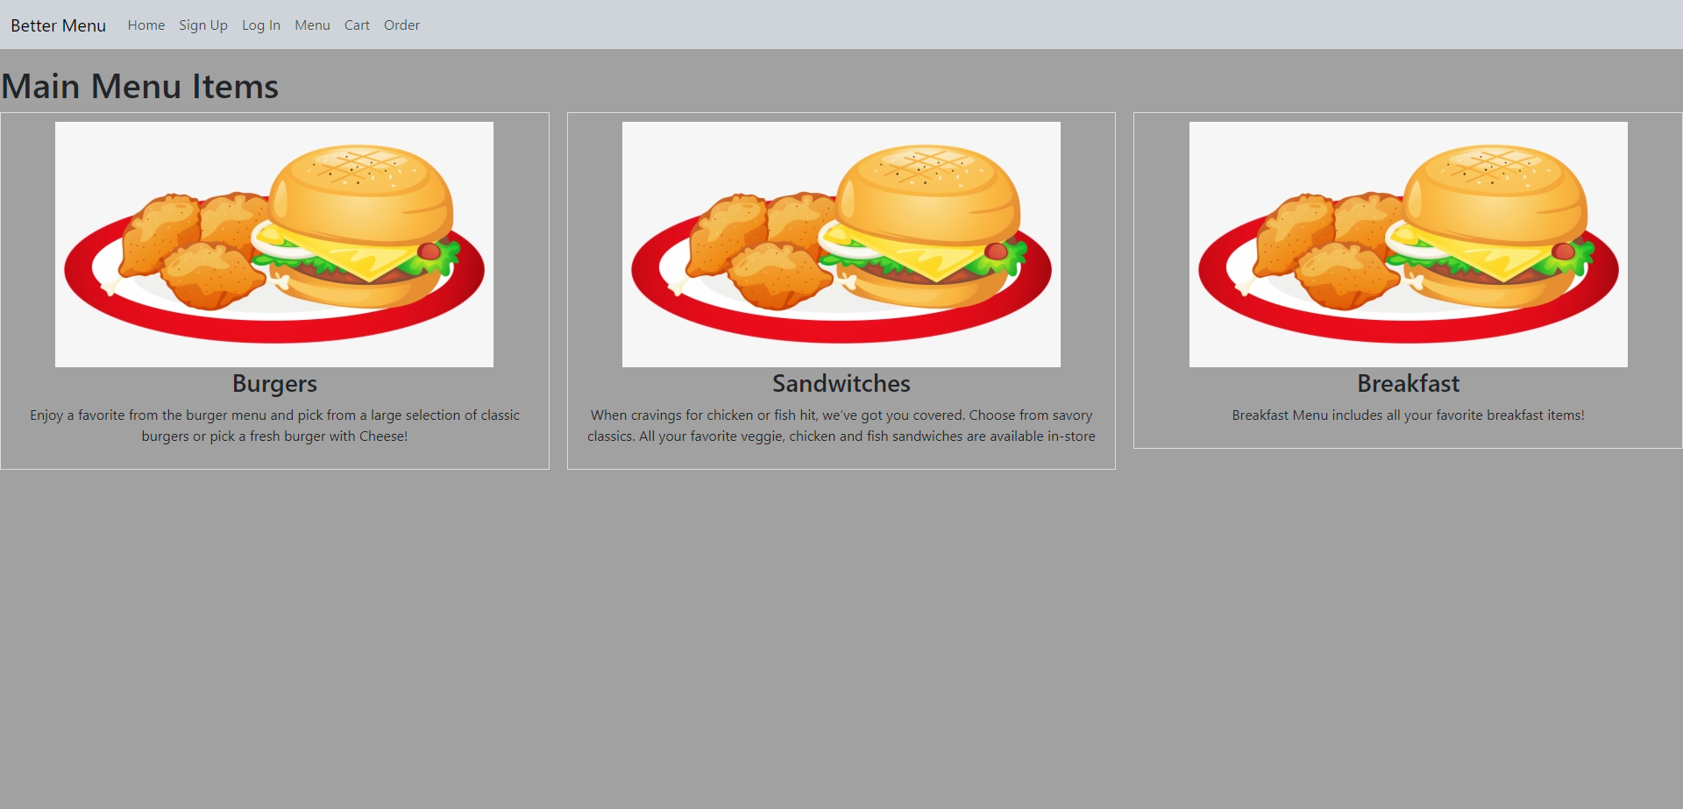

Slide 9
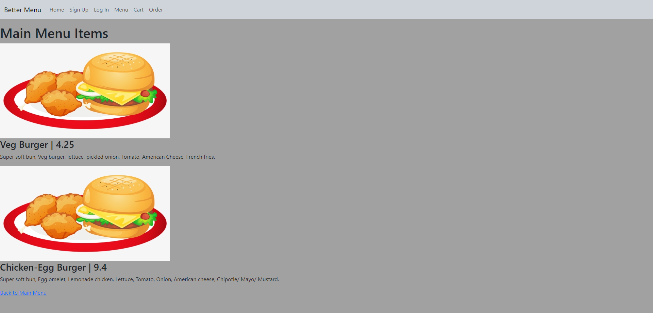

Slide 10
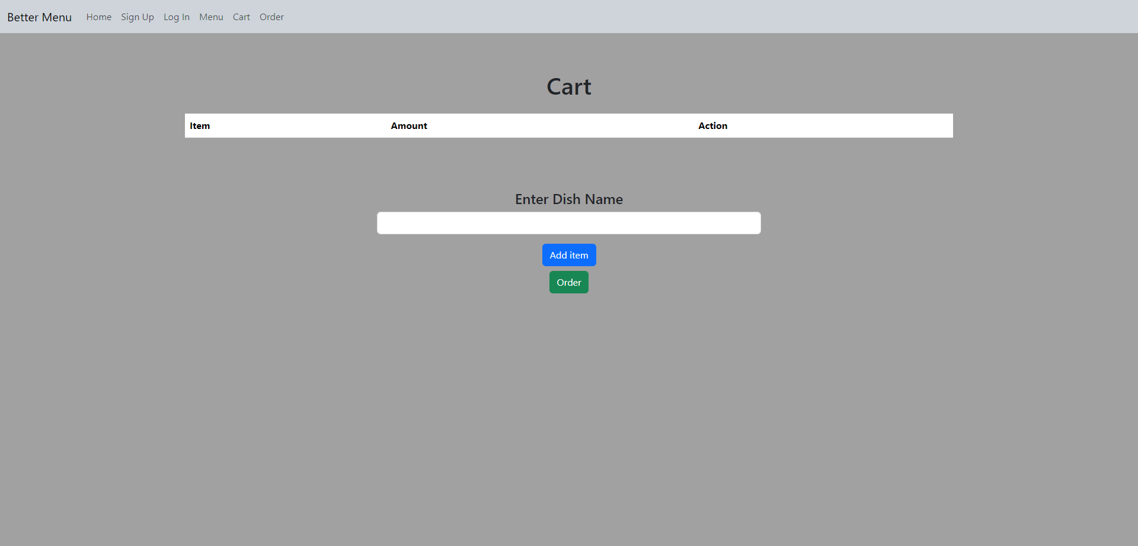

Slide 11
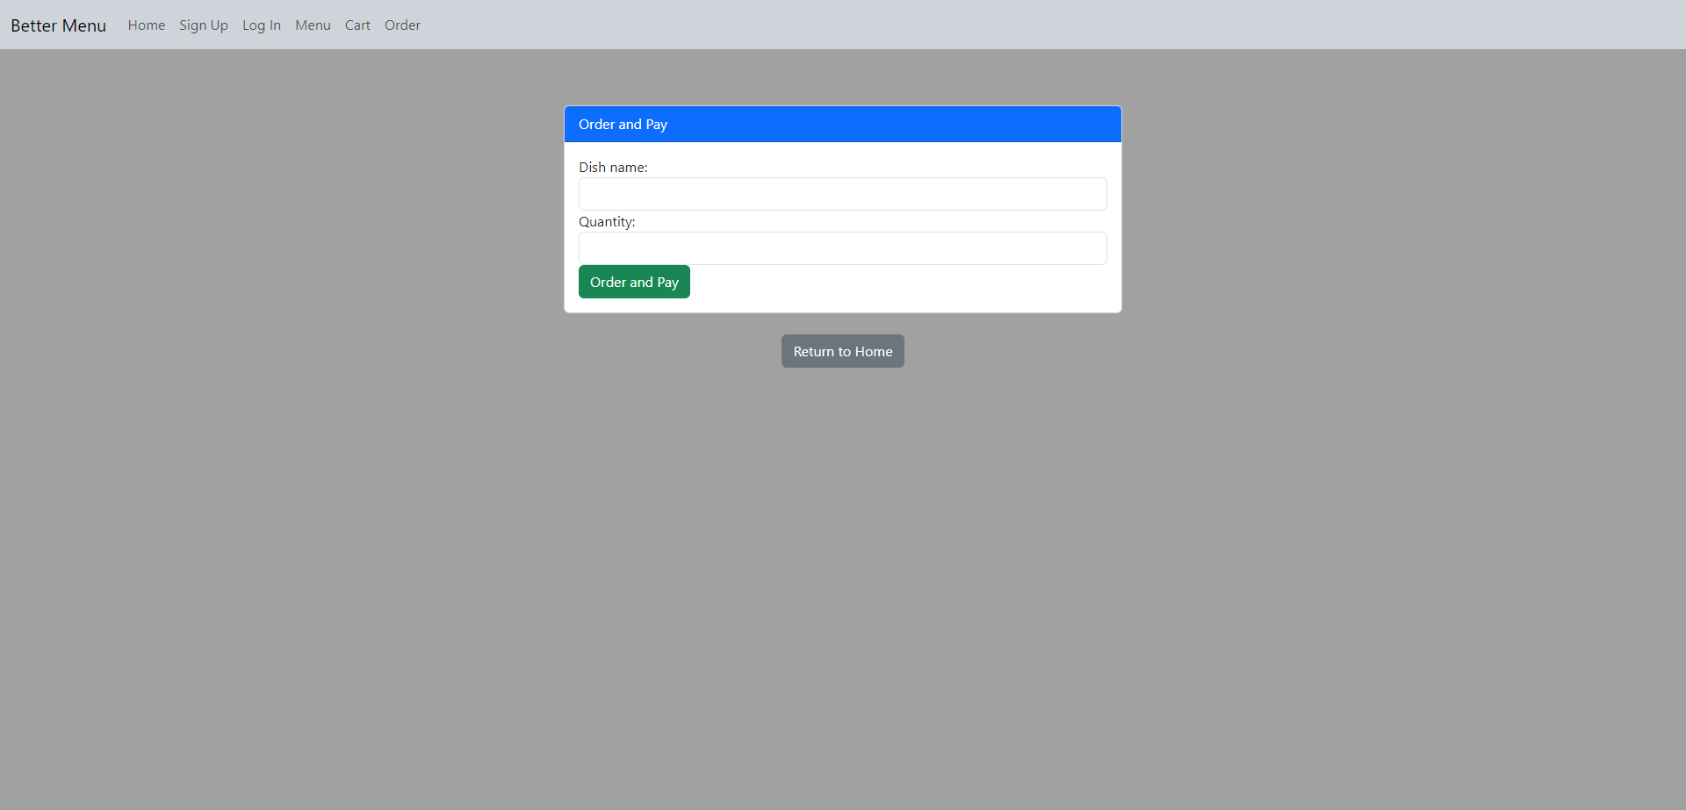

Slide 12
Database Design
Using Sqlite

Slide 13
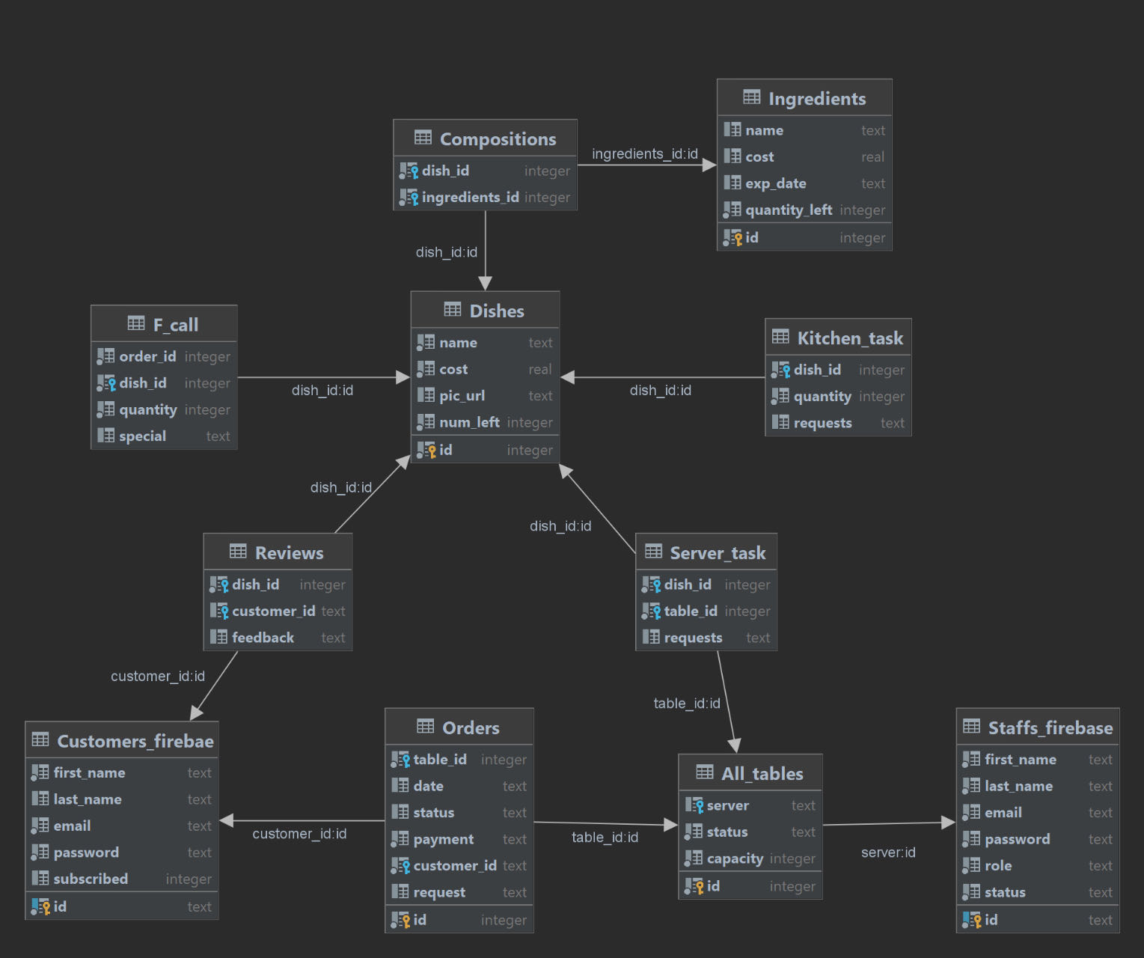

Slide 14
Thank you!
Siyuan Xue, Team Leader
Tony Xiang, Configuration Leader
Zhuoru Song, Requirement Leader

